Slide 1
Predicting the weather
Maths and the environment

Slide 2
How our teaching resources are designed for the classroom

Slide 3
I can use a simple model to predict the weather.

Slide 4
A forecast is a prediction of a future event occurring (based on data).
Extrapolation is the process of estimating unknown values that are outside the range of existing data.

Slide 5

Predicting the weather
Rainfall forecasting
Using historical data to predict the weather

Slide 6
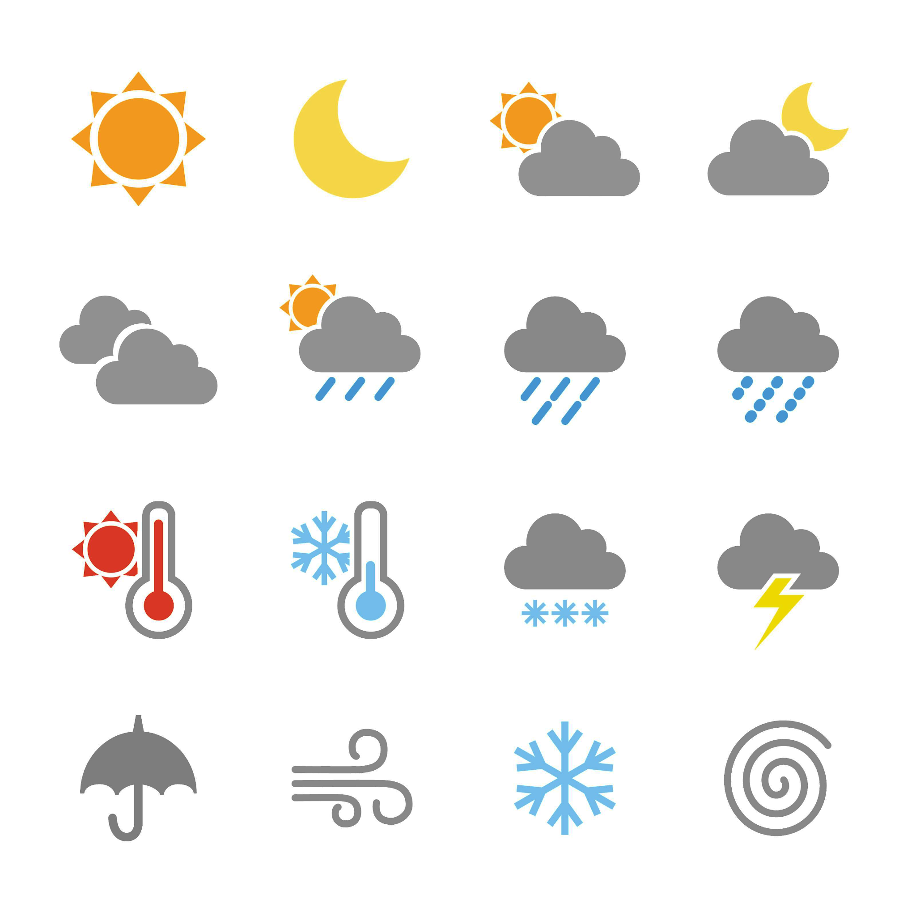


Rainfall forecasting
Weather reports can include a lot of information about rain.
06:00 | 10:00 | 14:00 | 18:00
type of rainfall
chance of rainfall
55% | 70% | 80% | 10%
amount of rainfall (in mm)
2 | 3.5 | 4.5 | 1
But what does all that information mean?
Surely the prediction is either it will rain or it won’t rain?
Andeep
Weather images: Raura7/ Shutterstock.com

Slide 7
Rainfall forecasting
There are different types of rainfall.
Rain showers are caused by individual clouds.
Rain showers can affect small areas, whilst leaving nearby areas dry.
rain shower
Rain is caused by large grey skies (rather than small clouds).
Rain lasts longer than rain showers, and can result in more rainfall.
rain
Heavy rain is also caused by large grey skies.
However, the amount of rain that falls each second is a lot greater.
Heavy rain can last as long as, or longer than, normal rain.
heavy rain
Weather images: Raura7/ Shutterstock.com

Slide 8
Rainfall forecasting
The amount of rain we predict will fall will differ depending on the type of rainfall predicted. For example…
rain shower
1 mm
Is 1 mm of rainfall a lot?
How much rain actually falls if the weather report says “1 mm of rain”?
rain
2.8 mm
Andeep
heavy rain
5 mm
Weather images: Raura7/ Shutterstock.com

Slide 9
Rainfall forecasting
If a rainfall event is predicted to produce “1 mm of rain”, then on any flat land affected by the rainfall, the rainwater would be 1 mm high.
rain shower
1 mm
“1 mm of rain” also means that every one square metre of area will have 1 litre of water fall on top of it.
patio area
1 litre
1 litre
1 litre
1 litre
If 1 mm of rain was predicted to fall, how much water would fall onto this patio area?
2 m
1 litre
1 litre
1 litre
1 litre
8 litres
4 m
Weather images: Raura7/ Shutterstock.com

Slide 10
Rainfall forecasting
12:00 | 18:00
At 10 am, this weather report is released, showing the weather for the rest of the day.
According to the weather report, how much rain is predicted to fall later on in the day per 1 square metre of area?
type of rainfall
amount of rainfall (in mm)
6.5 | 0
6.5 litres or 6500 ml of rain per 1 square metre.
Weather images: Raura7/ Shutterstock.com

Slide 11
Rainfall forecasting
12:00 | 18:00
This water butt has an open top to collect rainfall.
The area of its open top is 0.8 m².
type of rainfall
amount of rainfall (in mm)
6.5 | 0
How many litres of water will be collected by today’s predicted rainfall?
You can use this ratio table to help.
5.2 litres
 | area (m²) | rainfall (litres)
weather report | 1
water butt | 0.8
6.5
× 0.8
5.2
Weather images: Raura7/ Shutterstock.com

Slide 12
Rainfall forecasting
So, if I see this weather report, then it’s guaranteed that there will be a rain shower and 2 mm of rain will fall?
12:00
type of rainfall
chance of rainfall
80%
amount of rainfall (in mm)
2
Andeep
A weather forecast is a prediction of something that might happen in the future.
A lot of factors (including the size of a cloud, wind direction and wind speed, pressure fronts, etc.) go into a weather prediction.
Because of these factors, some predictions about rainfall will be more or less accurate than others.
Weather images: Raura7/ Shutterstock.com

Slide 13

Rainfall forecasting
12:00
80% is pretty big, that means it’s definitely going to rain!
type of rainfall
chance of rainfall
80%
Is Andeep correct?
amount of rainfall (in mm)
2
Andeep
The greater the “chance of rainfall” percentage, the more likely it is that rain will fall in that area at around that period of time.
I don’t think so!
Any percentage less than 100% means it isn’t guaranteed to rain!
Laura
Weather images: Raura7/ Shutterstock.com

Slide 14
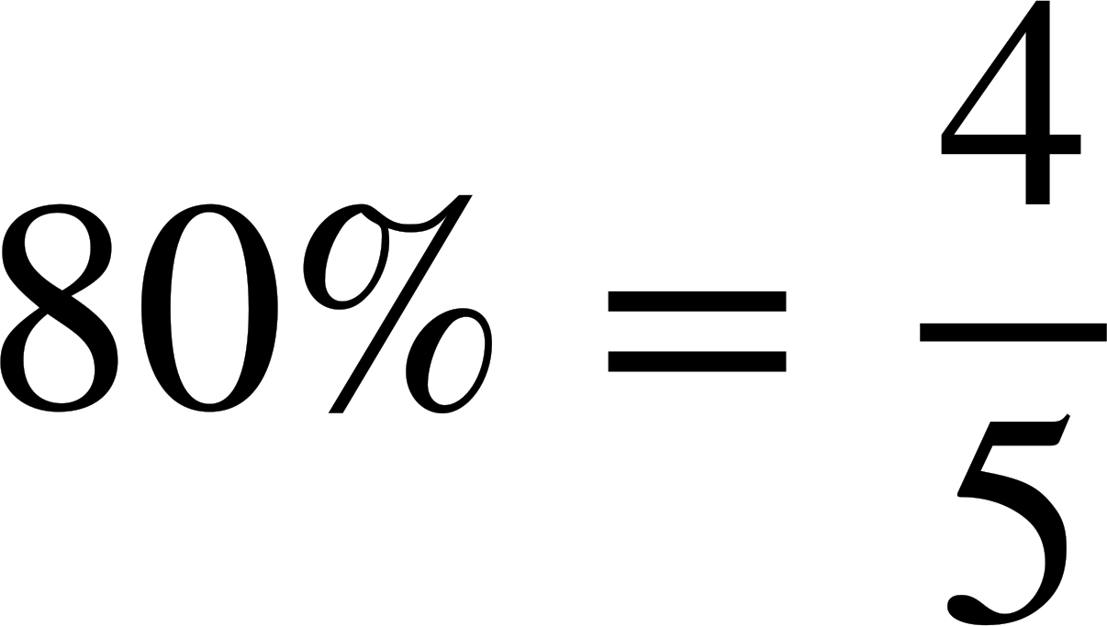
Rainfall forecasting
12:00
14:00
16:00
18:00
20:00
type of rainfall
chance of rainfall
80%
80%
80%
80%
80%
amount of rainfall (in mm)
2
2
2
2
2
did rain actually fall?
✓ | ✘ | ✓ | ✓ | ✓
If there are 5 periods of time, each with an 80% chance of rainfall, then it is “expected” that in 4 of those periods rain will actually fall.
Weather images: Raura7/ Shutterstock.com

Slide 15
Rainfall forecasting
12:00
14:00
16:00
18:00
20:00
type of rainfall
chance of rainfall
80%
80%
80%
80%
80%
amount of rainfall (in mm)
2
2
2
2
2
did rain actually fall?
✘ | ✘ | ✘ | ✘ | ✘
However, just because we “expect” 4 out of 5 periods of time to result in rain, this doesn’t mean there will be exactly 4 periods of rainfall.
We are more likely to see around 4 of those 5 periods of time result in rainfall…
But, it is possible for any amount of rain to fall, including no rainfall at all. This is just a very unlikely, extreme outcome.
Weather images: Raura7/ Shutterstock.com

Slide 16
Rainfall forecasting
12:00
14:00
16:00
18:00
20:00
type of rainfall
chance of rainfall
80%
80%
80%
80%
80%
amount of rainfall (in mm)
2
2
2
2
2
did rain actually fall?
✘ | ✘ | ✘ | ✘ | ✘
Imagine rolling a dice 5 times.
It is possible for the dice to land on the number “6” each and every time.
However, this outcome is very unlikely.
Weather images: Raura7/ Shutterstock.com

Slide 17
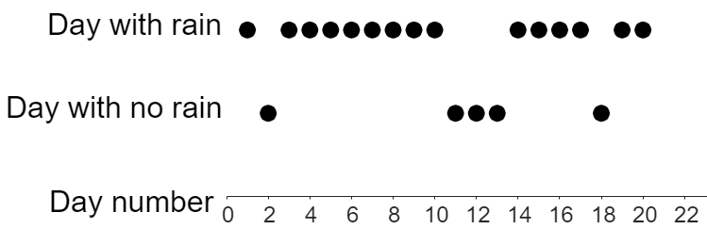
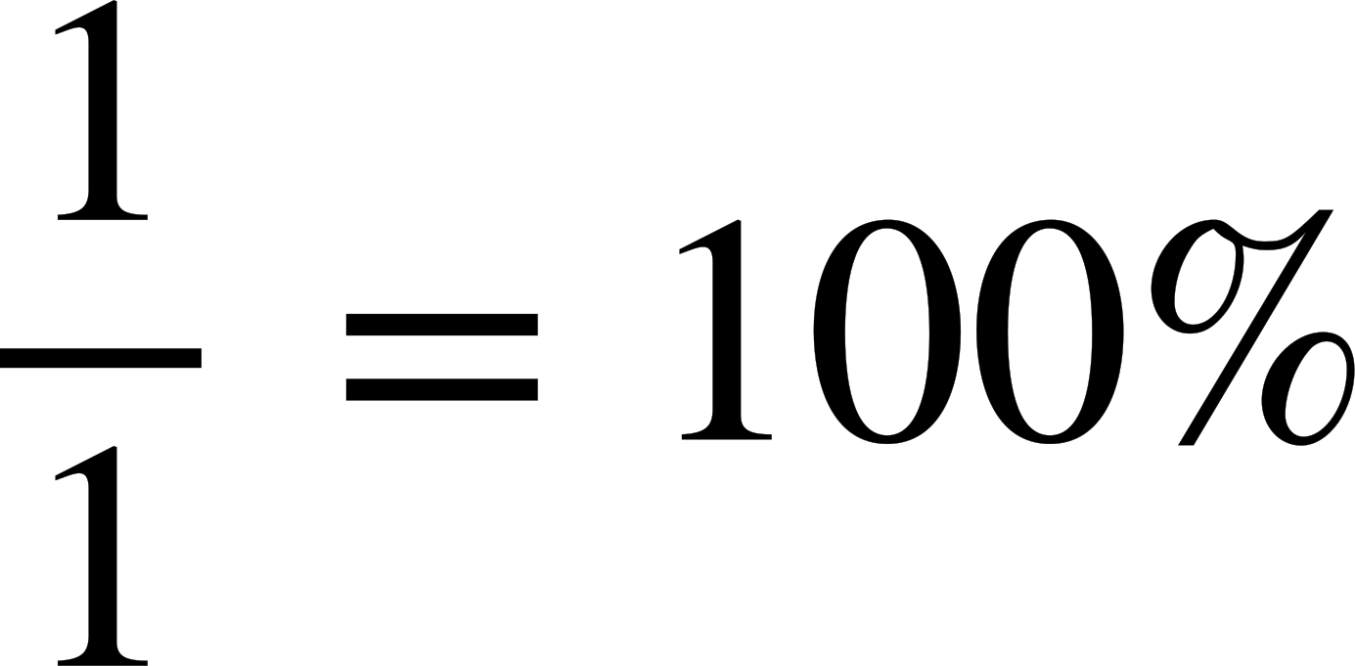
Rainfall forecasting
Here’s an example of how the reality may differ from a predicted forecast.
20 days in a row each have a predicted 80% chance of rainfall.
This timeline shows whether or not rain actually fell that day.
After 1 day, there is 1 day that rained.
100% of days had rainfall (not 80%).
Rainfall model 🖇

Slide 18
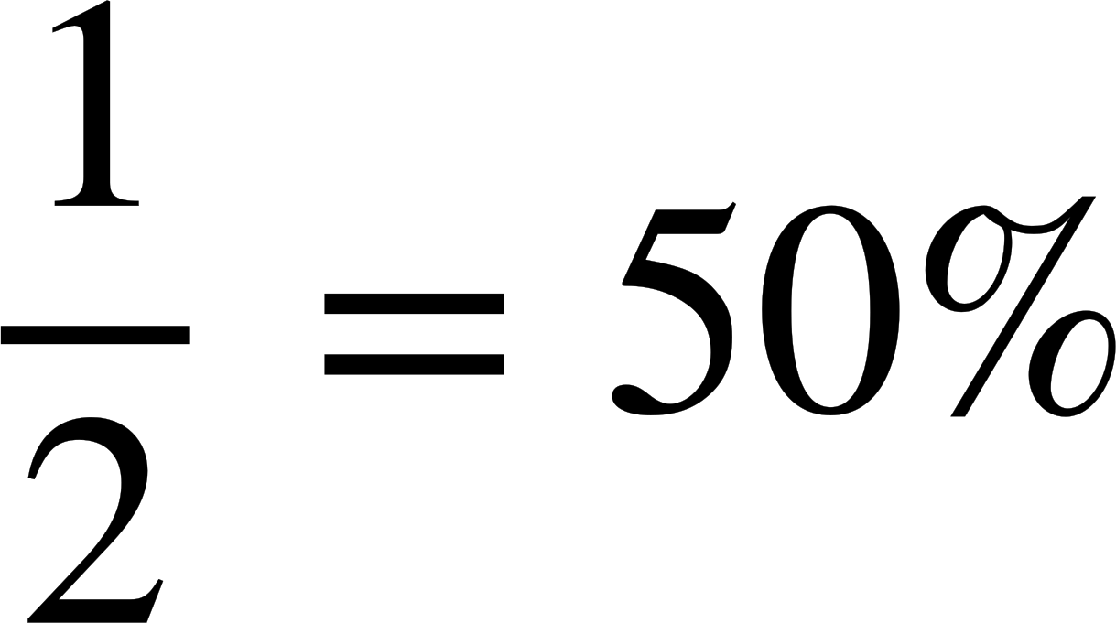
Rainfall forecasting
Here’s an example of how the reality may differ from a predicted forecast.
20 days in a row each have a predicted 80% chance of rainfall.
This timeline shows whether or not rain actually fell that day.
After 2 days, there is 1 day that rained.
50% of days had rainfall (not 80%).
Rainfall model 🖇

Slide 19
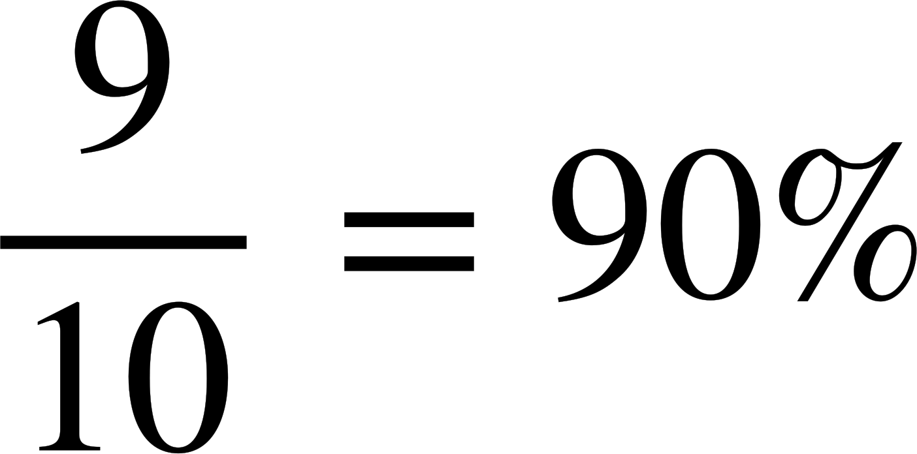
Rainfall forecasting
Here’s an example of how the reality may differ from a predicted forecast.
20 days in a row each have a predicted 80% chance of rainfall.
This timeline shows whether or not rain actually fell that day.
After 10 days, there are 9 days that rained.
90% of days had rainfall (not 80%).
Rainfall model 🖇

Slide 20
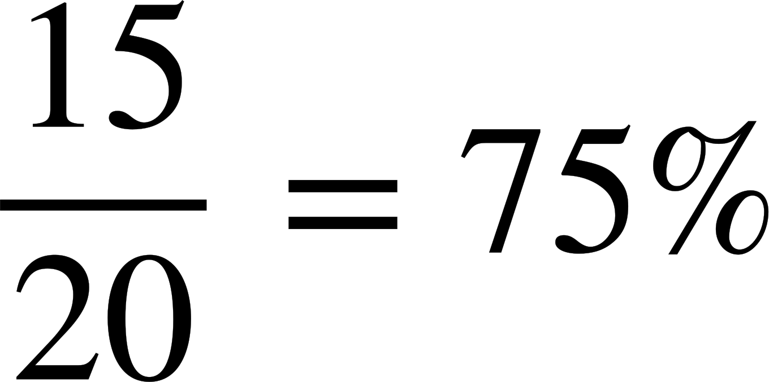
Rainfall forecasting
Here’s an example of how the reality may differ from a predicted forecast.
20 days in a row each have a predicted 80% chance of rainfall.
This timeline shows whether or not rain actually fell that day.
After 20 days, there are 15 days that rained.
75% of days had rainfall (not 80%).
Rainfall model 🖇

Slide 21
Rainfall forecasting
Whilst at no point did exactly 80% of days have rainfall (as predicted), the percentage was usually in a range of numbers close to 80%.
This became more and more true the greater the number of days that were analysed.
Rainfall model 🖇

Slide 22
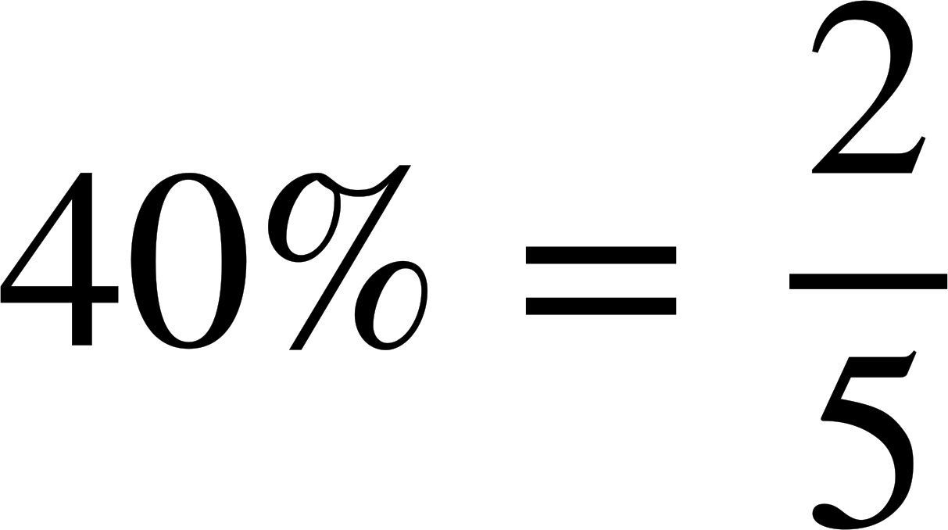
Rainfall forecasting
Mon
Tues
Wed
Thu
Fri
type of rainfall
chance of rainfall
40%
40%
40%
40%
40%
amount of rainfall (in mm)
2
2
2
2
2
The weather forecast for next week predicts five days, each with the same chance of rainfall.
From this weather forecast, on how many days should we expect rain to fall?
2 days
Weather images: Raura7/ Shutterstock.com

Slide 23




Rainfall forecasting
Mon
Tues
Wed
Thu
Fri
type of rainfall
Rain actually fell on all five days.
chance of rainfall
40%
40%
40%
40%
40%
amount of rainfall (in mm)
2
2
2
2
2
Whose statements are guaranteed to be correct?
Reality can differ from even accurate predictions.
The model used to predict the weather was definitely wrong!
The weather prediction was incorrect.
Aisha
Izzy
Jun
Weather images: Raura7/ Shutterstock.com

Slide 24
Rainfall forecasting
Mon
Tues
Wed
Thu
Fri
type of rainfall
Rain actually fell on all five days.
chance of rainfall
40%
40%
40%
40%
40%
amount of rainfall (in mm)
2
2
2
2
2
5 days is not a large enough sample size to make this judgement fairly.
The model may be more accurate across several months or years.
Jun’s assumption may not be correct.
Just because a weather forecast prediction over 5 days does not come true does not mean the model used to predict the weather is inaccurate.
The model used to predict the weather was definitely wrong!
Jun
Weather images: Raura7/ Shutterstock.com

Slide 25
Rainfall forecasting
1) This report was published on Saturday, and shows the forecast for the next week.
Mon | Tues
Wed | Thu
type of rainfall
amount of rainfall (in mm)
chance of rainfall
75% | 40% | 15% | 90%
a) Match the following amounts of rainfall to the days they are most likely to occur.
0.7 mm
1.6 mm
5 mm
8.5 mm
b) Sofia says: “it is guaranteed to rain on Thursday because 90% is a larger number than the other percentages”. Explain why Sofia is incorrect.
c) Suggest one possible reason why Wednesday still has a chance of rain, even though it is only predicted to be cloudy.
Weather images: Raura7/ Shutterstock.com

Slide 26
Rainfall forecasting
2) This report shows the amount of rainfall predicted on Saturday and Sunday.
Sat | Sun
type of rainfall
a) On Saturday, how many litres of water is predicted to fall for every square metre of land?
amount of rainfall (in mm)
7.5 | 2
chance of rainfall
100% | 73%
area (m²) | rainfall
1
A farmer has a field that is 1800 m² in area.
b) How many litres of rain will fall on this field on Saturday? You can use the ratio table given to help.
c) The farmer says: “3600 litres of rain will fall on my field on Sunday”.
Explain why this may not be true.
Weather images: Raura7/ Shutterstock.com

Slide 27
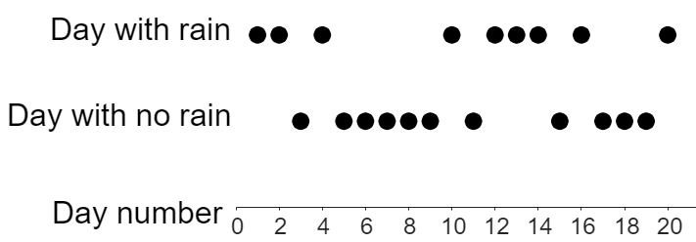
Rainfall forecasting
3) This graph shows 20 days where the chance of rainfall was 35%.
Each dot represents a day that either rained or didn’t rain.
a) How many of these 20 days would we expect to have rain?
b) Complete this table of information for the first 5 days on the graph.
c) What percentage of days for the first 10 days on the graph had rain?
Number of days | 5
Number of days with rain
% of days with rain
d) Does this graph show: “fewer than”, “equal to”, or “greater than” 35% of days with rain?

Slide 28
Rainfall forecasting
1) This report was published on Saturday, and shows the forecast for the next week.
Mon | Tues
Wed | Thu
type of rainfall
amount of rainfall (in mm)
5 | 1.6 | 0.7 | 8.5
chance of rainfall
75% | 40% | 15% | 90%
a) Match the following amounts of rainfall to the days they are most likely to occur.
0.7 mm
1.6 mm
5 mm
8.5 mm
Weather images: Raura7/ Shutterstock.com

Slide 29
Rainfall forecasting
1) This report was published on Saturday, and shows the forecast for the next week.
Mon | Tues
Wed | Thu
type of rainfall
amount of rainfall (in mm)
5 | 1.6 | 0.7 | 8.5
chance of rainfall
75% | 40% | 15% | 90%
b) Sofia says: “it is guaranteed to rain on Thursday because 90% is a larger number than the other percentages”. Explain why Sofia is incorrect.
The weather prediction for any one day may not always be correct (even if the model used to predict the weather is accurate).
Also, a 90% chance does not mean rain is guaranteed, only very likely. On 1 in every 10 days with a 90% chance of rain, it is expected that it will not rain.
Weather images: Raura7/ Shutterstock.com

Slide 30
Rainfall forecasting
1) This report was published on Saturday, and shows the forecast for the next week.
Mon | Tues
Wed | Thu
type of rainfall
amount of rainfall (in mm)
5 | 1.6 | 0.7 | 8.5
chance of rainfall
75% | 40% | 15% | 90%
c) Suggest one possible reason why Wednesday still has a chance of rain, even though it is only predicted to be cloudy.
It may be hard to predict whether the group of clouds that are modelled to form will be rain clouds (resulting in showers) or clouds that won’t produce rain.
This is especially true since a lot of contributing factors could change between Saturday (the time the forecast was made) and Wednesday.
Weather images: Raura7/ Shutterstock.com

Slide 31
Rainfall forecasting
2) This report shows the amount of rainfall predicted on Saturday and Sunday.
Sat | Sun
type of rainfall
a) On Saturday, how many litres of water is predicted to fall for every square metre of land?
amount of rainfall (in mm)
7.5 | 2
chance of rainfall
100% | 73%
7.5 litres
area (m²) | rainfall
1
A farmer has a field that is 1800 m² in area.
b) How many litres of rain will fall on this field on Saturday? You can use the ratio table given to help.
7.5 litres
1800
13 500 litres
Weather images: Raura7/ Shutterstock.com

Slide 32
Rainfall forecasting
2) This report shows the amount of rainfall predicted on Saturday and Sunday.
Sat | Sun
type of rainfall
amount of rainfall (in mm)
7.5 | 2
chance of rainfall
100% | 73%
c) The farmer says: “3600 litres of rain will fall on my field on Sunday”.
Explain why this may not be true.
area (m²) | rainfall
1
7.5 litres
There is only a 73% chance that it will rain on Sunday.
This means that there is a 27% chance that no rain will fall onto the field.
1800
13 500 litres
Weather images: Raura7/ Shutterstock.com

Slide 33
Rainfall forecasting
2) This report shows the amount of rainfall predicted on Saturday and Sunday.
Sat | Sun
type of rainfall
amount of rainfall (in mm)
7.5 | 2
chance of rainfall
100% | 73%
c) The farmer says: “3600 litres of rain will fall on my field on Sunday”.
Explain why this may not be true.
area (m²) | rainfall
1
7.5 litres
Even if it does rain, the amount of rainfall is also only a prediction.
It could rain more or less than 2 mm on Sunday.
1800
13 500 litres
Weather images: Raura7/ Shutterstock.com

Slide 34
Rainfall forecasting
3) This graph shows 20 days where the chance of rainfall was 35%.
Each dot represents a day that either rained or didn’t rain.
a) How many of these 20 days would we expect to have rain?
b) Complete this table of information for the first 5 days on the graph.
35% of 20 = 7
We would expect around 7 days of rain.
Number of days | 5
Number of days with rain | 3
% of days with rain | 60%

Slide 35
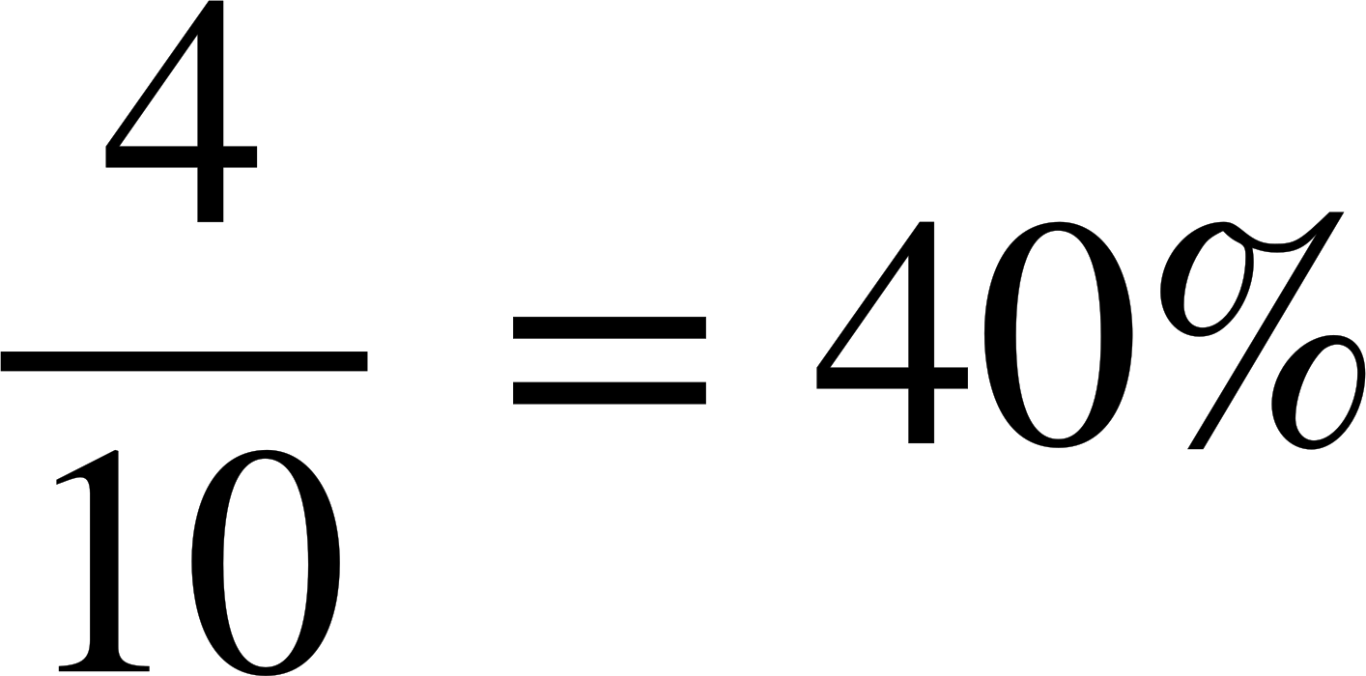
Rainfall forecasting
3) This graph shows 20 days where the chance of rainfall was 35%.
Each dot represents a day that either rained or didn’t rain.
c) What percentage of days for the first 10 days on the graph had rain?
40% of the first 10 days had rain.
d) Does this graph show: “fewer than”, “equal to”, or “greater than” 35% of days with rain?
Greater than. This is because 9 of the 20 days (45%) had rain, not the 7 (35%) that was predicted.

Slide 36
Predicting the weather
Rainfall forecasting
Using historical data to predict the weather

Slide 37
Using historical data to predict the weather
It is possible to use patterns or trends from historical data in order to predict future weather forecasts.
Historical data can be plotted on a time-series graph. Trends from the graph can then be extrapolated to predict what the graph will look like in future years.

Slide 38
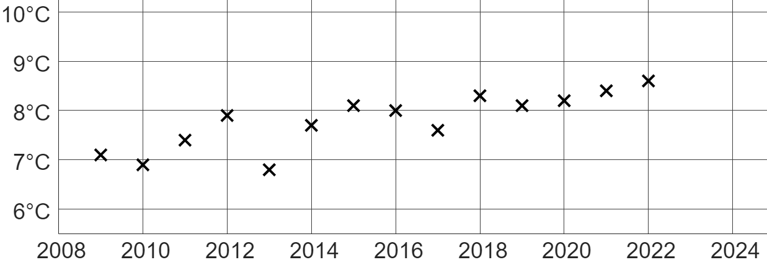
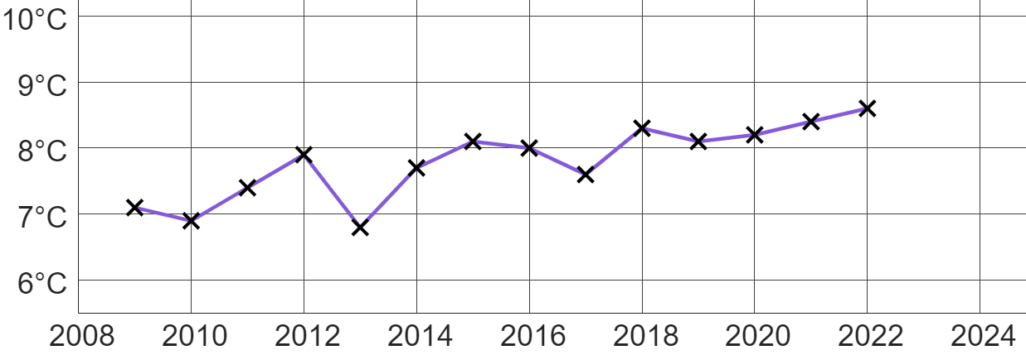
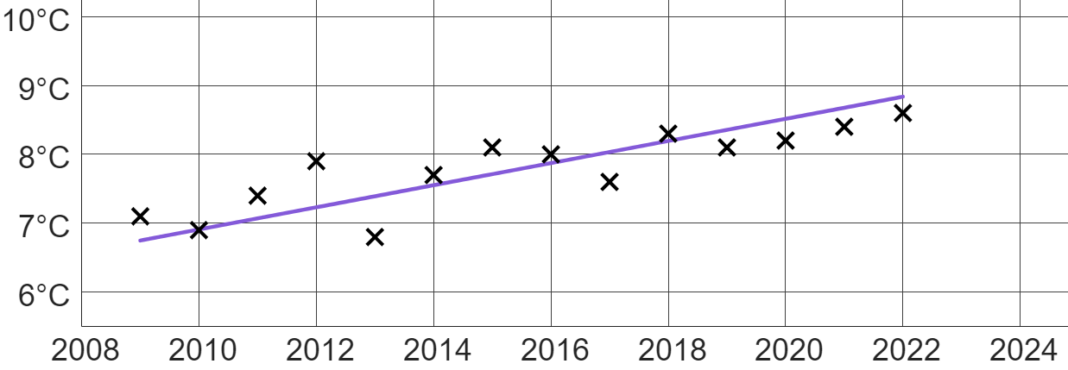
Using historical data to predict the weather
This graph shows the mean night-time temperature in November each year from 2009 to 2022 in Oakfield.
We can see that there is a bit of variety in temperatures when comparing one year to the next. This makes spotting longer-term trends tricky.
It is important to not focus on patterns between only two or three data points.
A trendline of the data can be used to identify that the temperatures are increasing over a longer period of time, even if temperatures may fluctuate from one year to the next.

Slide 39
Using historical data to predict the weather
This graph shows the mean night-time temperature in November each year from 2009 to 2022 in Oakfield.
When predicting future weather forecasts, we can extrapolate predictions using the trends seen in the historical time-series graph.
A basic way of predicting future temperatures is by extending the trendline.
Using this method, we have extrapolated that the mean night-time temperature in November 2023 will be 9°C.

Slide 40
Using historical data to predict the weather
This graph shows the mean night-time temperature in November each year from 2009 to 2022 in Oakfield.
However, extrapolation is unreliable when trying to make accurate predictions.
We can see from the historical data that the temperatures fluctuate each year, and so it is uncertain whether the trend in the future will continue on the same trendline…
or begin to change.

Slide 41
Using historical data to predict the weather
This graph shows the mean night-time temperature in November each year from 2009 to 2022 in Oakfield.
So, rather than using a trendline, a broader range of the trend can be used…
and then extrapolated.
This range can then be used as a prediction of likely temperatures.
Using this method, we have extrapolated that the mean night-time temperature in November 2023 will likely be between 8.3°C and 9.6°C.

Slide 42
Using historical data to predict the weather
This graph shows the mean night-time temperature in November each year from 2009 to 2022 in Oakfield.
This predicted range of temperatures may then be modified and improved using other data, such as measurements of current weather conditions in Oakfield and elsewhere.
This current data is then analysed to see what influence it might have on the results extrapolated from historical data.

Slide 43
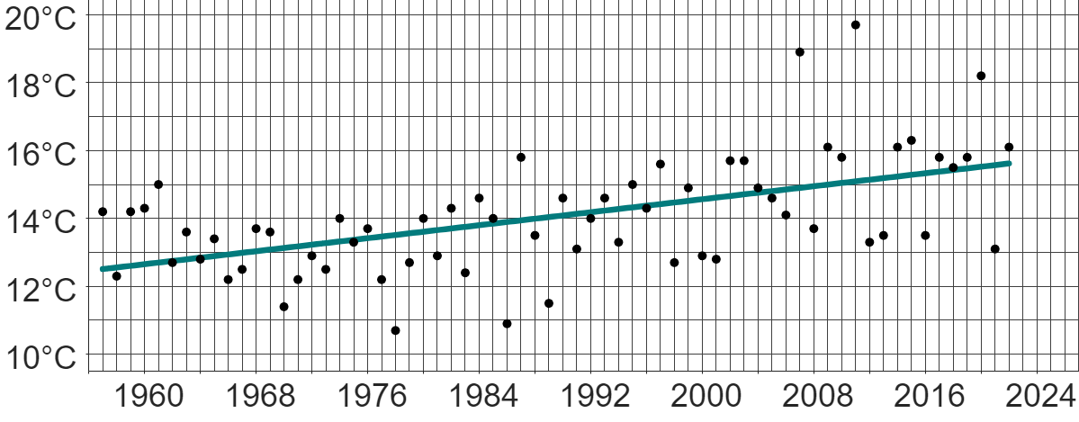

Using historical data to predict the weather
This graph shows data from the Met Office on the mean daily maximum temperature in April each year from 1957 to 2022 in Heathrow.
Which of these statements is correct about this data?
a
Each year, the temperature increases.
b
The trend of the temperatures over time shows an increase.
c
There is no trend because the temperatures fluctuate each year.
d
The gradient of the trendline is positive.

Slide 44
Using historical data to predict the weather
This graph shows data from the Met Office on the mean daily maximum temperature in April each year from 1957 to 2022 in Heathrow.
The trendline is extended to extrapolate and predict temperatures in the future.
Write down an estimate for the predicted mean daily maximum temperature in April 2023.
15.8°C

Slide 45
Using historical data to predict the weather
This graph shows data from the Met Office on the mean daily maximum temperature in April each year from 1957 to 2022 in Heathrow.
Which of these statements is correct about the extrapolated trendline?
a
The trend in the data is always guaranteed to continue in exactly the same way as previously observed.
b
It is difficult to predict whether the trend of the data will continue in the same way as previously observed.

Slide 46
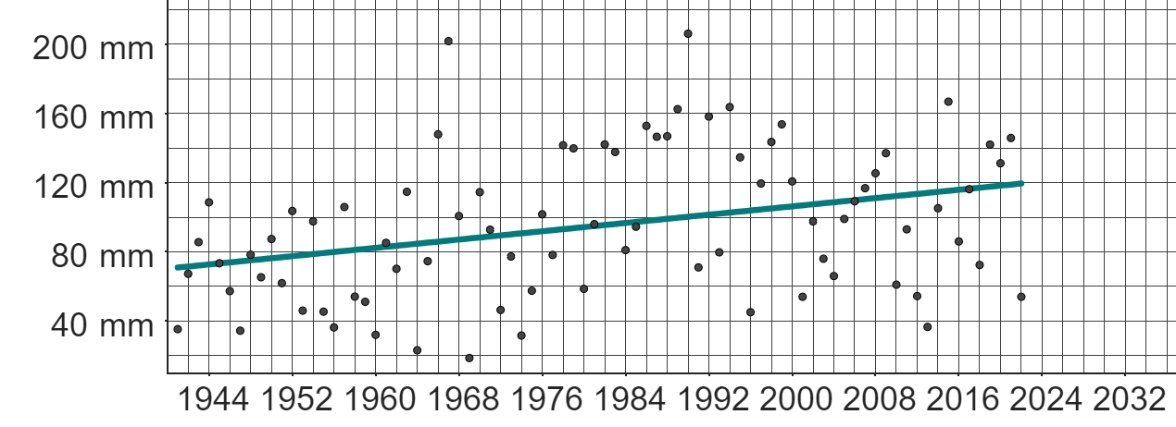
Using historical data to predict the weather
This graph shows data from the Met Office on the total monthly rainfall in March each year from 1941 to 2022 in Stornoway.
1a) Write a sentence explaining what the trendline is suggesting about the total amount of monthly rainfall each March.
b) Izzy says:
“The amount of rainfall in March 2022 is lower than in March 2021. This means the amount of rainfall in March 2023 will be even lower”.
Explain why Izzy’s assumption may not be correct.

Slide 47
Using historical data to predict the weather
This graph shows data from the Met Office on the total monthly rainfall in March each year from 1941 to 2022 in Stornoway.
c) Extend the trendline beyond 2022.
d) Using your extended trendline, make a prediction for the total amount of rainfall in March 2024.
e) Explain why your prediction in part d) may not be accurate.
f) Suggest a suitable range of likely predictions by considering a broader trend in the data.

Slide 48
Using historical data to predict the weather
This graph shows data from the Met Office on the total monthly rainfall in March each year from 1941 to 2022 in Stornoway.
week 1 | week 2 | week 3 | week 4 | week 5
12°C | 13°C | 9°C | 11°C | 13°C
g) If this was the weather forecast for March 2024 in Stornoway (based on weather conditions at the end of February 2024), explain how this might impact your prediction from part c).
Weather images: Raura7/ Shutterstock.com

Slide 49
Using historical data to predict the weather
This graph shows data from the Met Office on the total monthly rainfall in March each year from 1941 to 2022 in Stornoway.
1a) Write a sentence explaining what the trendline is suggesting about the total amount of monthly rainfall each March.
The trendline is suggesting that the amount of rainfall each March is increasing over long periods of time.
This does not mean that the amount of rainfall each March will always be greater than the previous year.

Slide 50
Using historical data to predict the weather
This graph shows data from the Met Office on the total monthly rainfall in March each year from 1941 to 2022 in Stornoway.
b) Izzy says:
“The amount of rainfall in March 2022 is lower than in March 2021. This means the amount of rainfall in March 2023 will be even lower”.
Explain why Izzy’s assumption may not be correct.
The trendline is suggesting the opposite thing.
It is important to look at longer-term trends, rather than the fluctuations between only two consecutive years.

Slide 51
Using historical data to predict the weather
This graph shows data from the Met Office on the total monthly rainfall in March each year from 1941 to 2022 in Stornoway.
c) Extend the trendline beyond 2022.
d) Using your extended trendline, make a prediction for the total amount of rainfall in March 2024.
A prediction of approximately 120 mm.

Slide 52
Using historical data to predict the weather
This graph shows data from the Met Office on the total monthly rainfall in March each year from 1941 to 2022 in Stornoway.
e) Explain why your prediction in part d) may not be accurate.
f) Suggest a suitable range of likely predictions by considering a broader trend in the data.
There is a lot of variation in March rainfall from year to year.
Future rainfall may not follow the same long-term trend as previous years.
Approximately between 75 mm and 165 mm.

Slide 53
Using historical data to predict the weather
This graph shows data from the Met Office on the total monthly rainfall in March each year from 1941 to 2022 in Stornoway.
week 1 | week 2 | week 3 | week 4 | week 5
12°C | 13°C | 9°C | 11°C | 13°C
g) If this was the weather forecast for March 2024 in Stornoway (based on weather conditions at the end of February 2024), explain how this might impact your prediction from part c).
Weather images: Raura7/ Shutterstock.com

Slide 54
Using historical data to predict the weather
This graph shows data from the Met Office on the total monthly rainfall in March each year from 1941 to 2022 in Stornoway.
week 1 | week 2 | week 3 | week 4 | week 5
12°C | 13°C | 9°C | 11°C | 13°C
The weather report suggests that March 2024 will be a sunny month, with little significant rainfall. This may mean that
there is less rainfall than the trend suggests from previous Marches. This means the prediction of 120 mm might be too high.
Weather images: Raura7/ Shutterstock.com

Slide 55
Using historical data to predict the weather
This graph shows data from the Met Office on the total monthly rainfall in March each year from 1941 to 2022 in Stornoway.
week 1 | week 2 | week 3 | week 4 | week 5
12°C | 13°C | 9°C | 11°C | 13°C
It is helpful to consider current weather data (such as weather conditions from the previous month) to modify and improve predictions based on historical data.
Weather images: Raura7/ Shutterstock.com

Slide 56
Predicting the weather
There are different types of rainfall, based on the different types of rain cloud. Each type of rainfall may produce different quantities of rain.
If the "chance of rainfall" is less than 100%, then there is a chance that rain will not fall at a certain location, even if rainfall is predicted.
This does not mean that the model used to predict the rainfall is wrong.
Predictions about weather can be based on longer-term trends in historical data.
Predictions using historical data may not be accurate, as there is no guarantee future data will follow the trends of the past.
This is especially true if the historical data fluctuates significantly from year to year.

Slide 57

© Oak National Academy 2024.
Produced in partnership with Mathematics in Education and Industry.
Licensed on the Open Government Licence v3.0, except where otherwise stated. See Oak terms and conditions.

